Slide 1
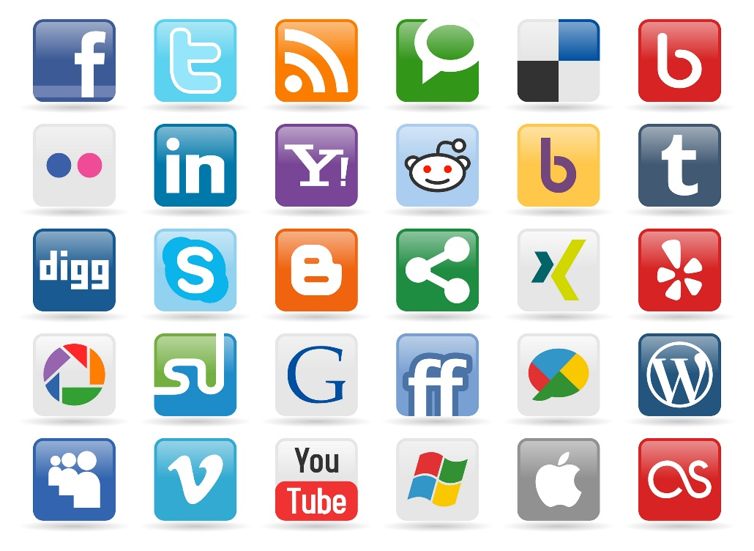

Behavior Analytics
SOCIAL
MEDIA
MINING

Slide 2
Dear instructors/users of these slides: Please feel free to include these slides in your own material, or modify them as you see fit. If you decide to incorporate these slides into your presentations, please include the following note:
R. Zafarani, M. A. Abbasi, and H. Liu, Social Media Mining: An Introduction, Cambridge University Press, 2014.
Free book and slides at http://socialmediamining.info/
or include a link to the website: http://socialmediamining.info/

Slide 3

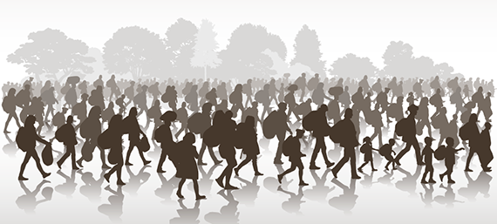

Examples of Behavior Analytics
What motivates users to join an online group?
When users abandon social media sites, where do they migrate to?
Can we predict box office revenues for movies from tweets?

Slide 4
Behavior Analysis
To answers these questions we need to analyze or predict behaviors on social media.
Users exhibit different behaviors on social media:
As individuals, or
As part of a broader collective behavior.
When discussing individual behavior,
Our focus is on one individual.
Collective behavior emerges when a population of individuals behave in a similar way with or without coordination or planning.

Slide 5
Our Goal
To analyze, model, and predict individual and collective behavior

Slide 6
Individual Behavior

Slide 7
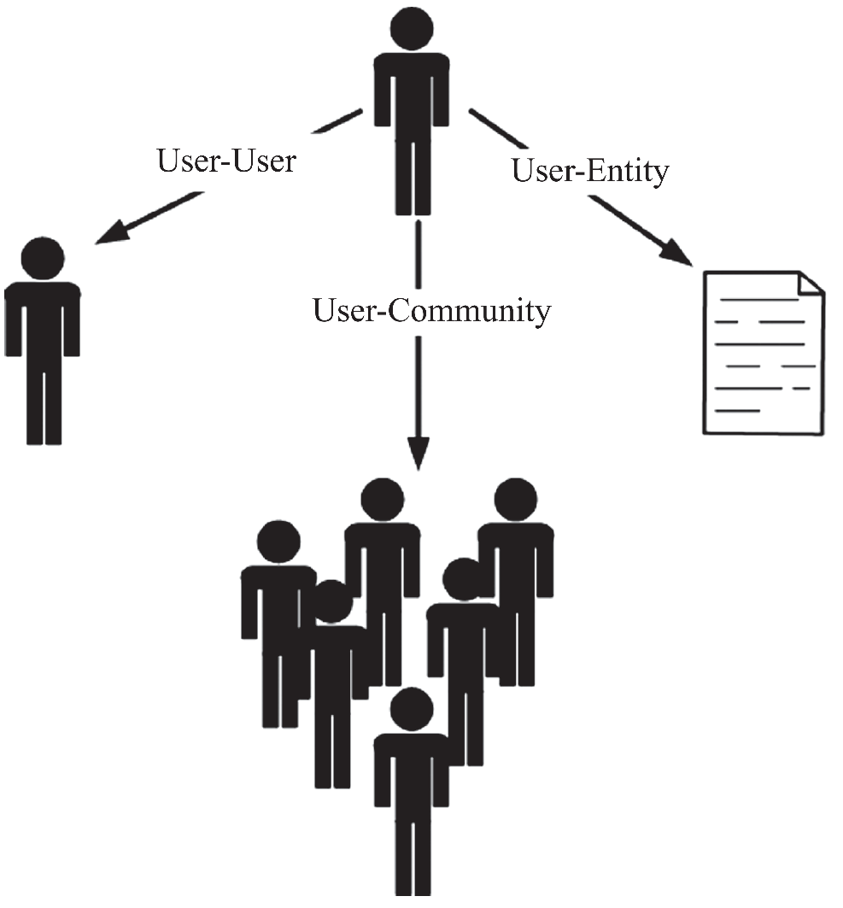
Types of Individual Behavior
User-User
(link generation)
befriending, sending a message, playing games, following, or inviting
User-Community
joining or leaving a community, participating in community discussions
User-Entity (content generation)
writing a post
posting a photo

Slide 8
I. Individual Behavior Analysis

Slide 9
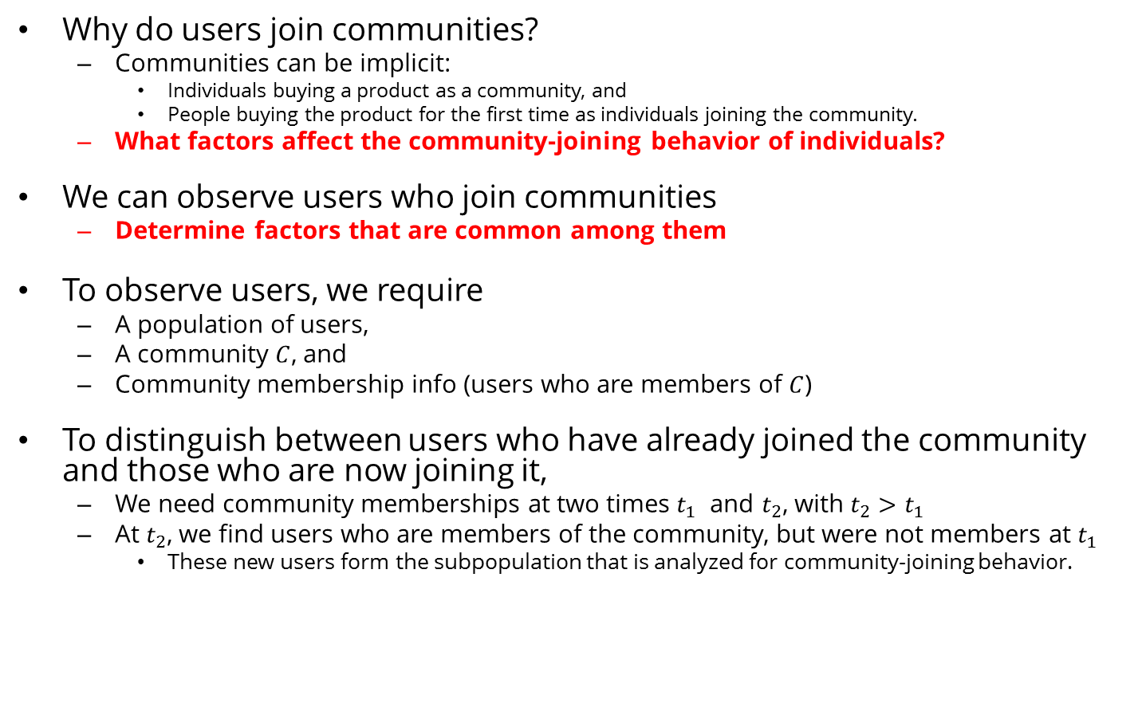
Example: Community Membership in Social Media
Why do users join communities?
Communities can be implicit:
Individuals buying a product as a community, and
People buying the product for the first time as individuals joining the community.
What factors affect the community-joining behavior of individuals?
We can observe users who join communities
Determine factors that are common among them
To observe users, we require
A population of users,
A community $C$, and
Community membership info (users who are members of $C$)
To distinguish between users who have already joined the community and those who are now joining it,
We need community memberships at two times $t_{1}$ and $t_{2}$, with $t_{2}>t_{1}$
At $t_{2}$, we find users who are members of the community, but were not members at $t_{1}$
These new users form the subpopulation that is analyzed for community-joining behavior.

Slide 10
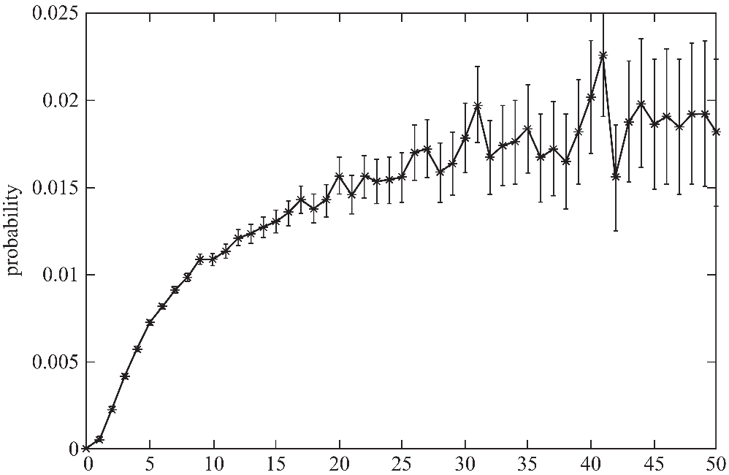
Community Membership in Social Media
Hypothesis:
individuals are inclined toward an activity when their friends are engaged in the same activity.
A factor that plays a role in users joining a community is the number of their friends who are already members of the community.
In data mining terms,
number of friends of an individual in a community
A feature to predict whether the individual joins the community (i.e., class attribute).
Number of Friends
vs
Probability of Joining
a Community
Backstrom, L., Huttenlocher, D., Kleinberg, J., & Lan, X. (2006, August). Group formation in large social networks: membership, growth, and evolution. In Proceedings of the 12th ACM SIGKDD international conference on Knowledge discovery and data mining (pp. 44-54). ACM.

Slide 11
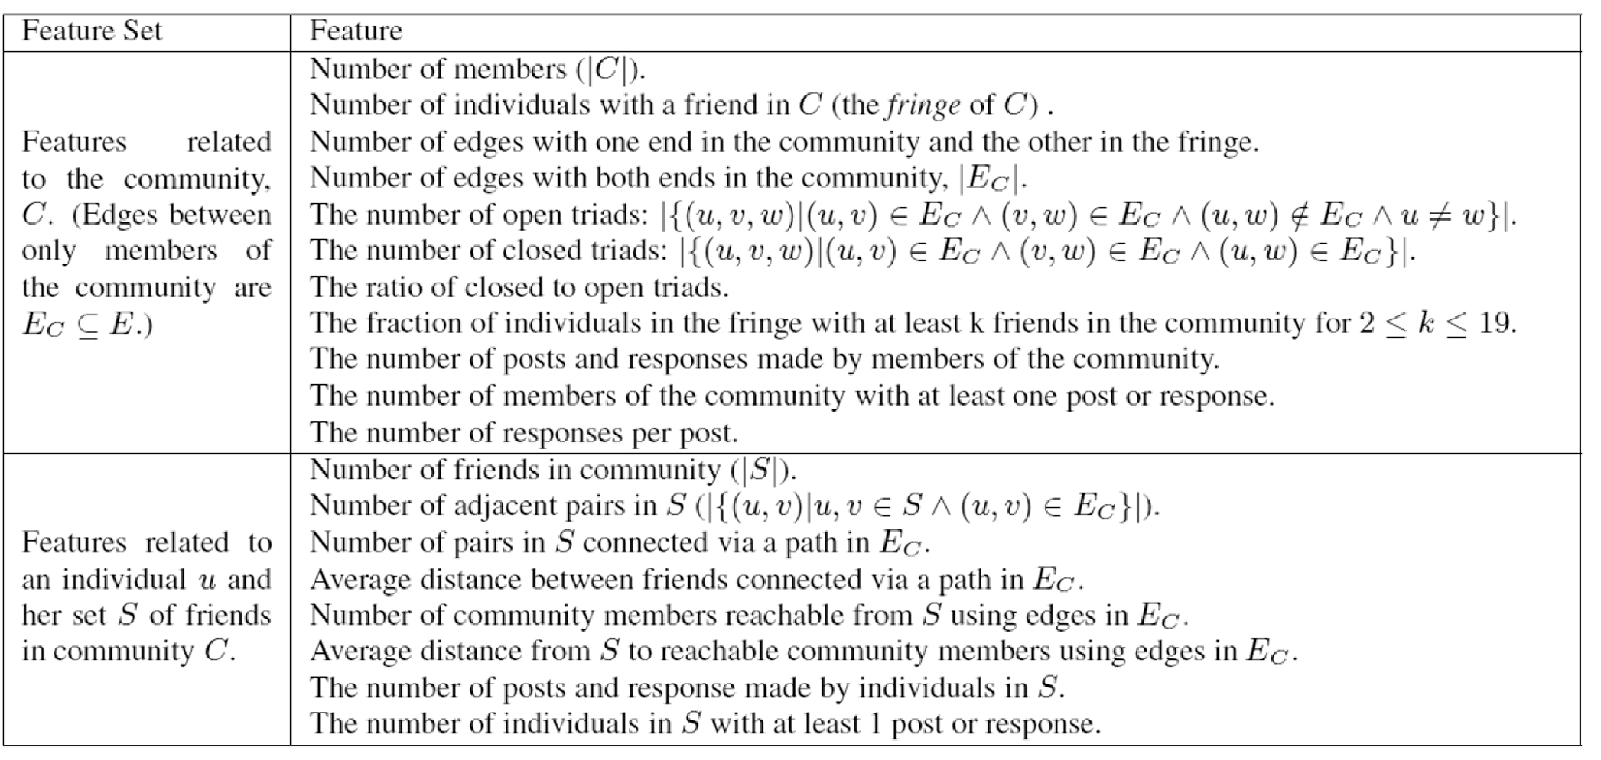
Even More Features

Slide 12
Feature Importance Analysis
Which feature can help best determine whether individuals will join or not?
We can use any feature selection algorithm, or
We can use a classification algorithm, such as decision tree learning
Most important Features are ranked higher

Slide 13
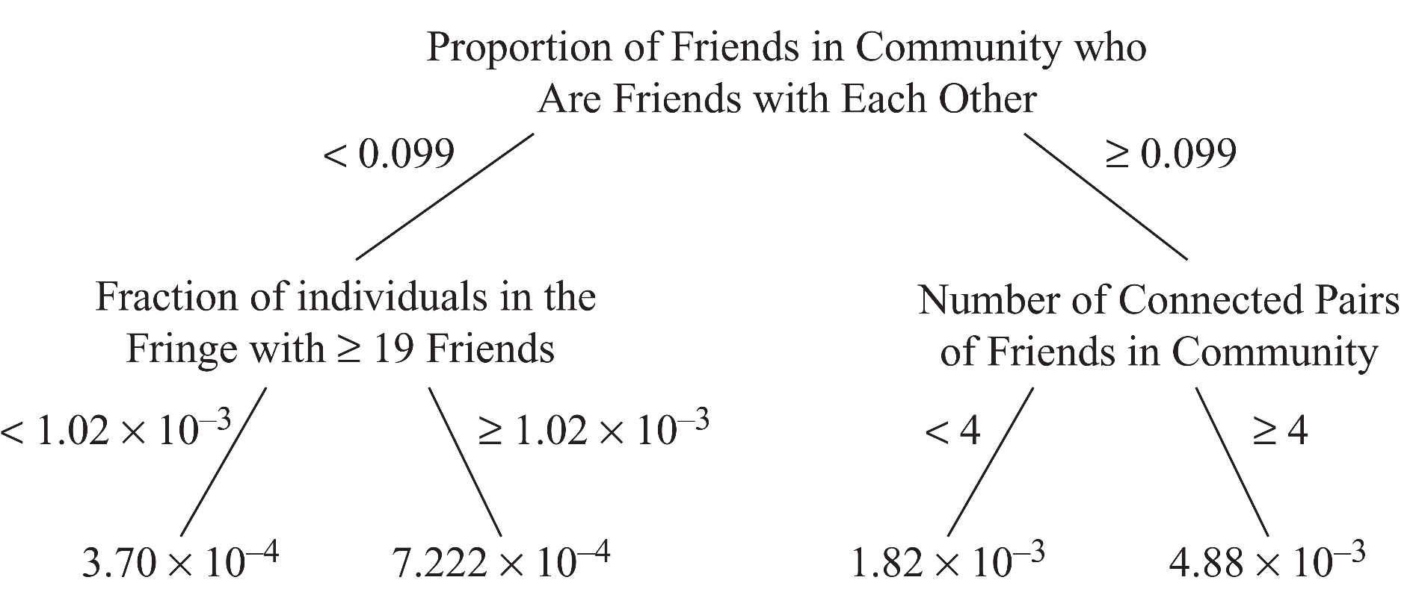
Decision Tree for Joining a Community
Are these features well-designed?
We can evaluate using classification performance metrics

Slide 14
Behavior Analysis Methodology
An observable behavior
The behavior needs to be observable
E.g., accurately observing the joining of individuals (and possibly their joining times)
Features:
Finding data features (covariates) that may or may not affect (or be affected by) the behavior
We need a domain expert for this step
Feature-Behavior Association:
Find the relationship between features and behavior
E.g., use decision tree learning
Evaluation:
The findings are due to the features and not to externalities.
E.g., we can use
classification accuracy
randomization tests (discussed later!)
or causality testing algorithms

Slide 15

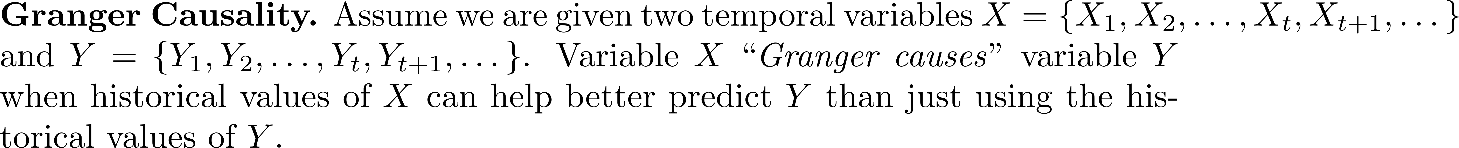
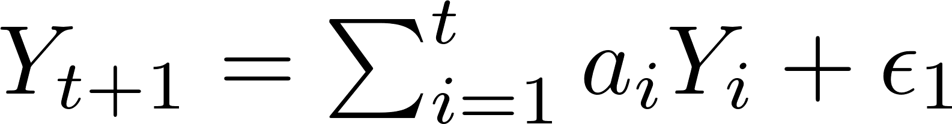
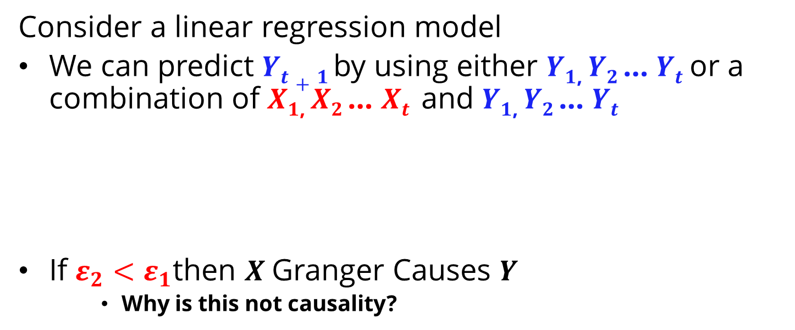
Granger Causality
Consider a linear regression model
We can predict $Yt+1$by using either $Y1$, $Y2$… $Yt$or a combination of $X1$, $X2$… $Xt$and $Y1$, $Y2$… $Yt$
If $ε_{2}<ε_{1}$then $X$Granger Causes $Y$
Why is this not causality?

Slide 16
II. Individual Behavior Modeling

Slide 17
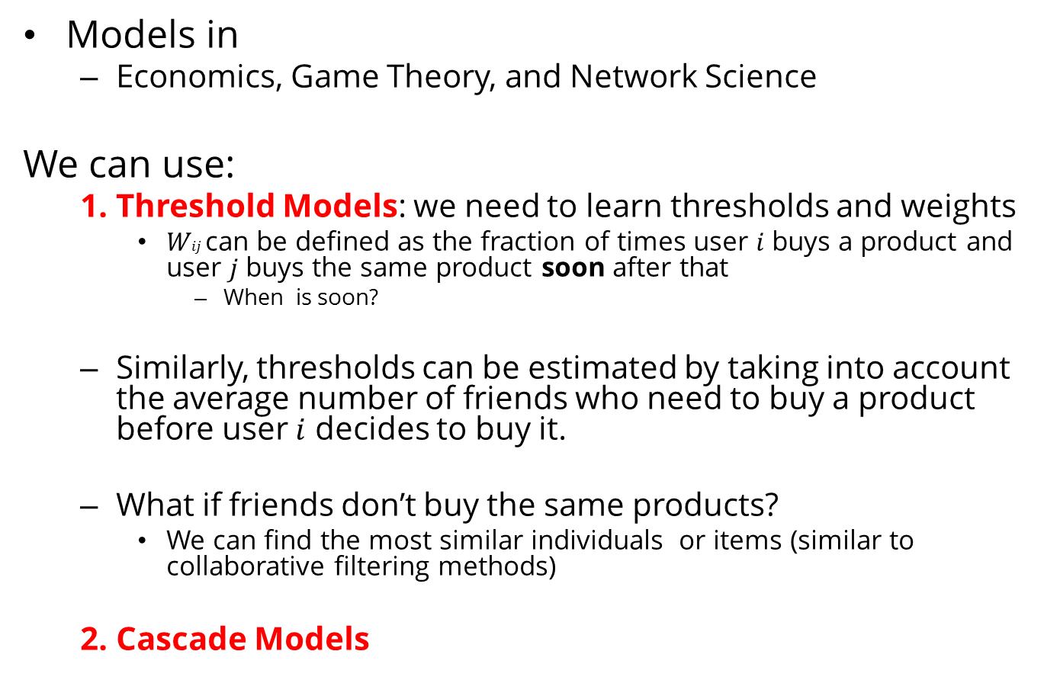
Individual Behavior Modeling
Models in
Economics, Game Theory, and Network Science
We can use:
1. Threshold Models: we need to learn thresholds and weights
$Wij$can be defined as the fraction of times user $i$ buys a product and user $j$ buys the same product soon after that
When is soon?
Similarly, thresholds can be estimated by taking into account the average number of friends who need to buy a product before user $i$ decides to buy it.
What if friends don’t buy the same products?
We can find the most similar individuals or items (similar to collaborative filtering methods)
2. Cascade Models

Slide 18
III. Individual Behavior Prediction

Slide 19
Individual Behavior Prediction
Most behaviors result in newly formed links in social media.
It can be a link to a user, as in befriending behavior;
A link to an entity, as in buying behavior; or
A link to a community, as in joining behavior.
We can formulate many of these behaviors as a link prediction problem.

Slide 20
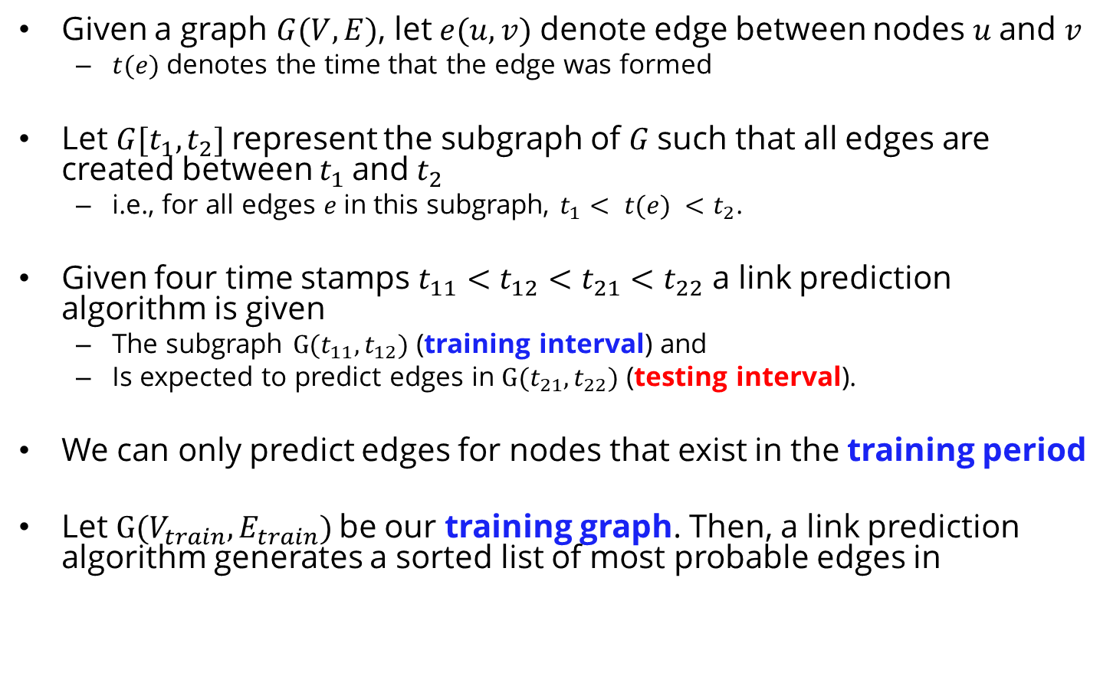
Link Prediction - Setup
Given a graph $G(V, E)$, let $e(u,v)$ denote edge between nodes $u$and $v$
$t(e)$ denotes the time that the edge was formed
Let $G[t_{1},t_{2}]$represent the subgraph of $G$such that all edges are created between $t_{1}$and${ t}_{2}$
i.e., for all edges $e$in this subgraph, $t_{1}< t(e) <$ $t_{2}$.
Given four time stamps $t_{11}<t_{12}<t_{21}<t_{22}$ a link prediction algorithm is given
The subgraph $G(t_{11},t_{12})$ (training interval) and
Is expected to predict edges in $G(t_{21},t_{22})$ (testing interval).
We can only predict edges for nodes that exist in the training period
Let $G(V_{train},E_{train})$be our training graph. Then, a link prediction algorithm generates a sorted list of most probable edges in

Slide 21
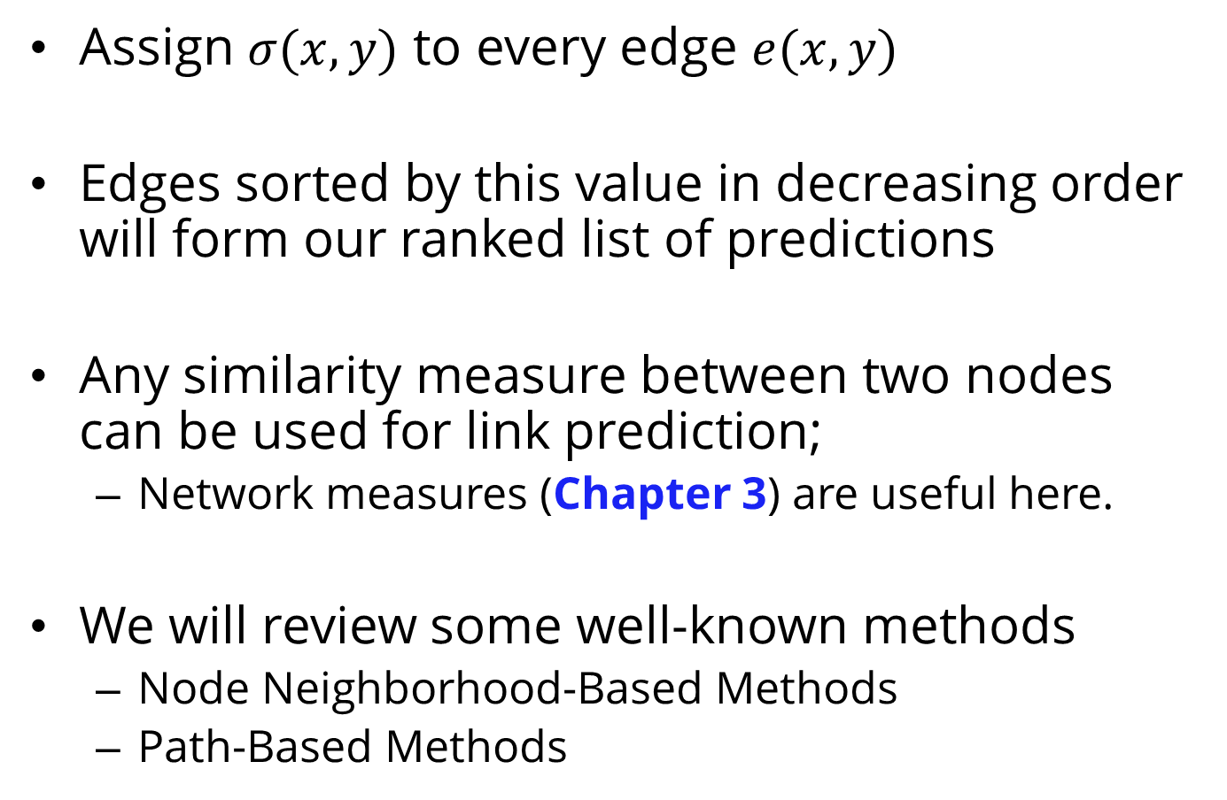
Link Prediction - Algorithms
Assign $σ(x,y)$ to every edge $e(x,y)$
Edges sorted by this value in decreasing order will form our ranked list of predictions
Any similarity measure between two nodes can be used for link prediction;
Network measures (Chapter 3) are useful here.
We will review some well-known methods
Node Neighborhood-Based Methods
Path-Based Methods

Slide 22
Node Neighborhood-Based Methods

Slide 23
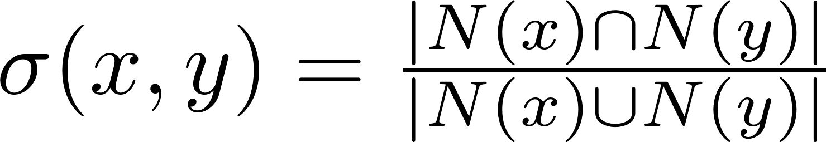
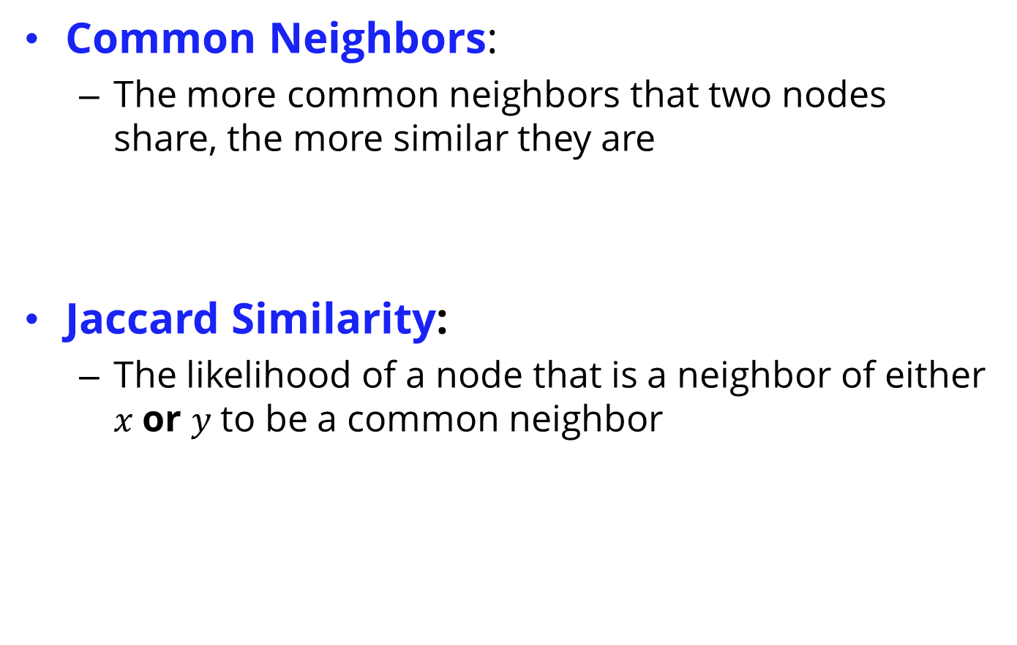
Node Neighborhood-Based Methods
Common Neighbors:
The more common neighbors that two nodes share, the more similar they are
Jaccard Similarity:
The likelihood of a node that is a neighbor of either $x$or $y$to be a common neighbor

Slide 24


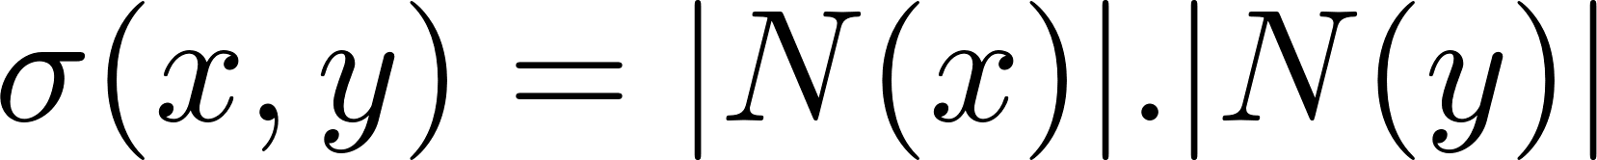
Node Neighborhood-Based Methods
Adamic-Adar:
If two individuals share a neighbor
and that neighbor is a rare neighbor,
it should have a higher impact on their similarity.
Preferential Attachment:
Nodes of higher degree have a higher chance of getting connected to incoming nodes
Rareness

Slide 25
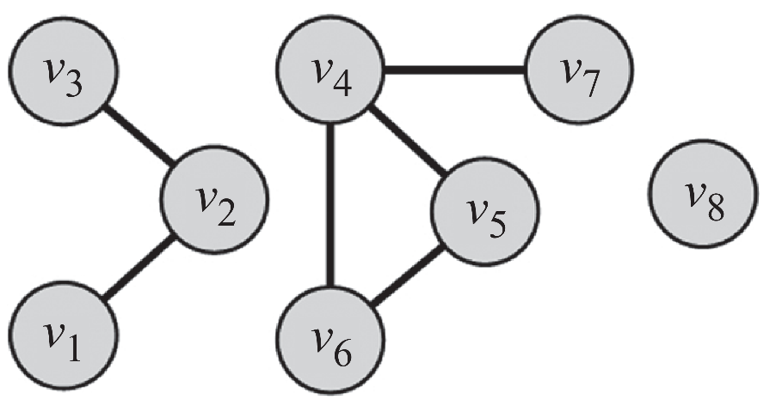
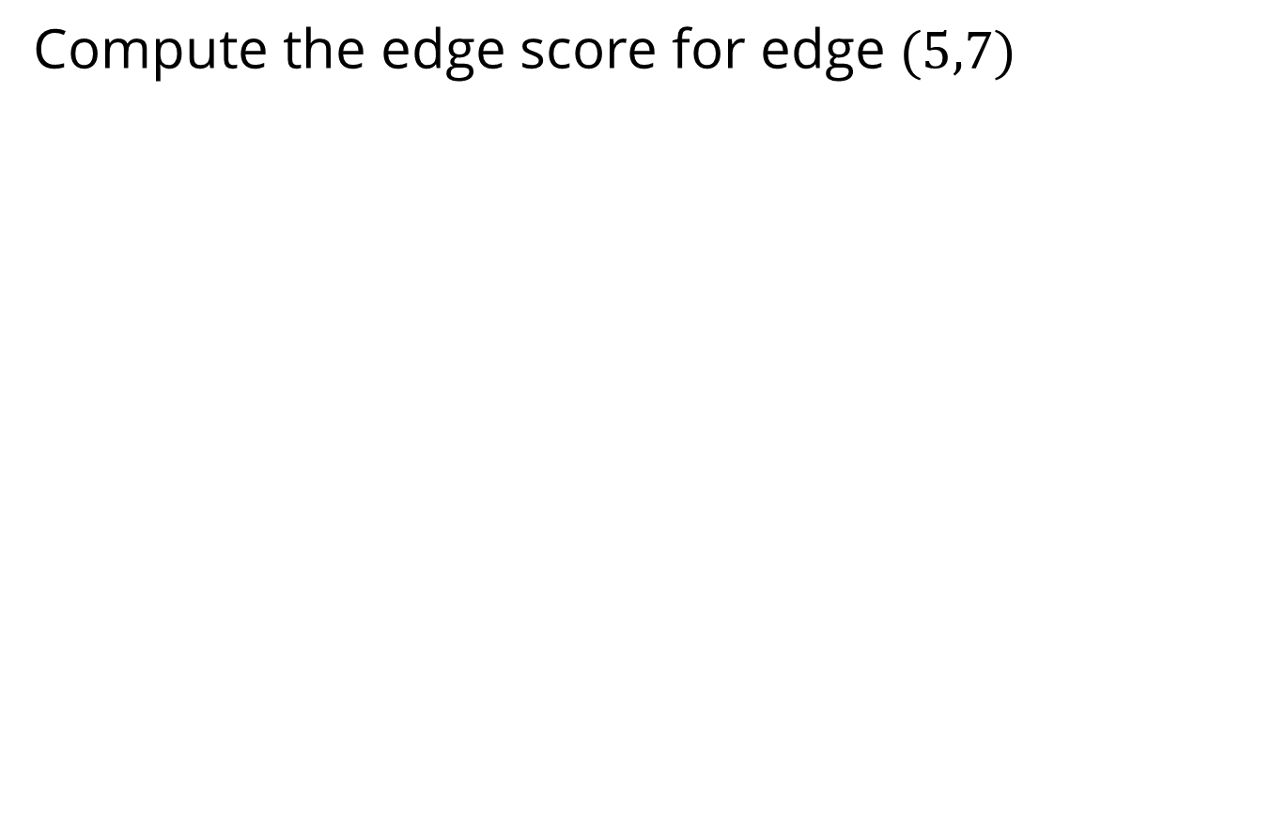
Example
Compute the edge score for edge $(5,7)$

Slide 26
Path-Based Methods

Slide 27
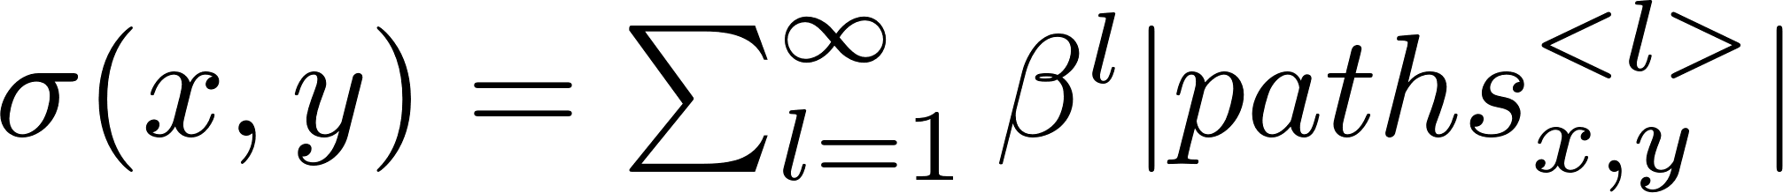
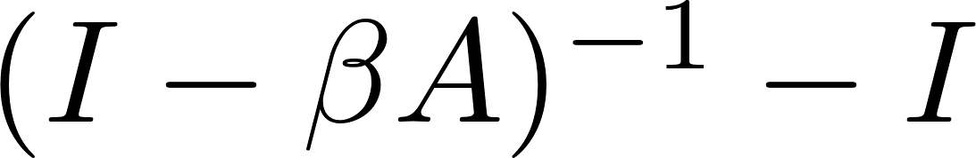
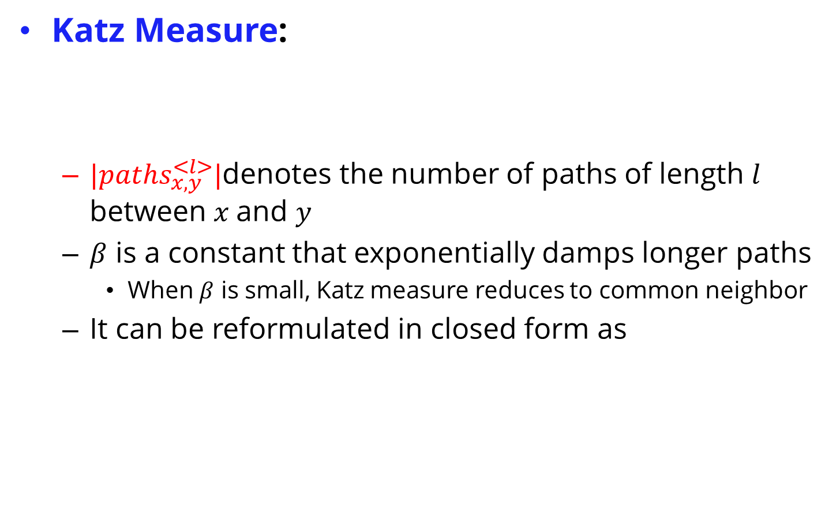
Path-Based Measures
Katz Measure:
${|paths}_{x,y}^{<l>}|$denotes the number of paths of length $l$ between $x$and $y$
$β$ is a constant that exponentially damps longer paths
When $β$ is small, Katz measure reduces to common neighbor
It can be reformulated in closed form as

Slide 28
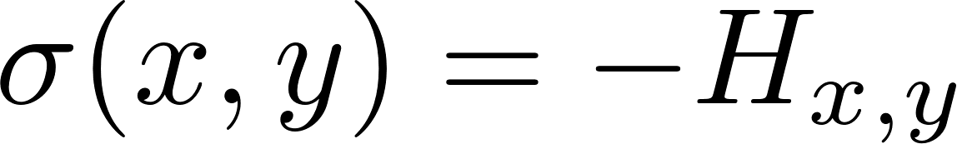
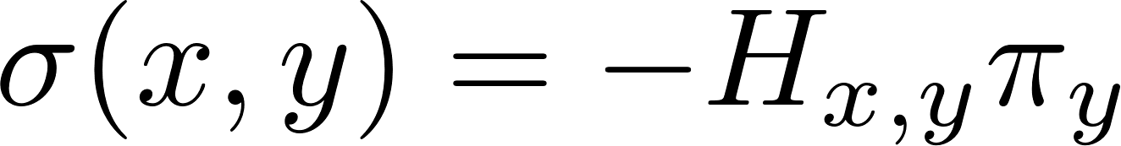
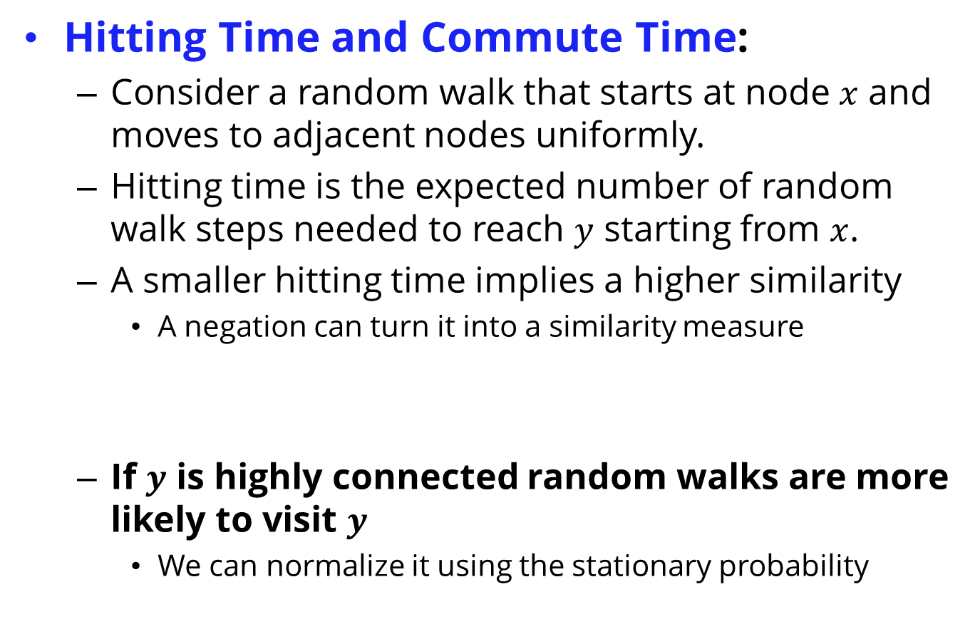
Path-Based Measures
Hitting Time and Commute Time:
Consider a random walk that starts at node $x$ and moves to adjacent nodes uniformly.
Hitting time is the expected number of random walk steps needed to reach $y$ starting from $x$.
A smaller hitting time implies a higher similarity
A negation can turn it into a similarity measure
If $y$ is highly connected random walks are more likely to visit $y$
We can normalize it using the stationary probability

Slide 29
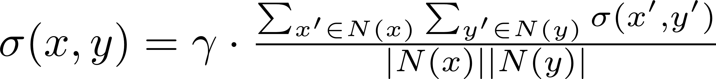
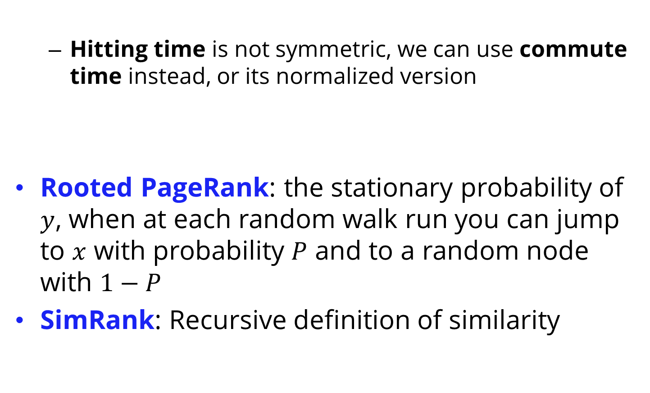
Path-Based Measures
Hitting time is not symmetric, we can use commute time instead, or its normalized version
Rooted PageRank: the stationary probability of $y$, when at each random walk run you can jump to $x$ with probability $P$ and to a random node with $1−P$
SimRank: Recursive definition of similarity

Slide 30
Link Prediction - Evaluation
After one of the aforementioned measures is selected, a list of the top most similar pairs of nodes are selected.
These pairs of nodes denote edges predicted to be the most likely to soon appear in the network.
Performance (precision, recall, or accuracy) can be evaluated using the testing graph and by comparing the number of the testing graph’s edges that the link prediction algorithm successfully reveals.
Performance is usually very low, since many edges are created due to reasons not solely available in a social network graph.
Solution: a common baseline is to compare the performance with random edge predictors and report the factor improvements over random prediction.

Slide 31
Collective Behavior

Slide 32
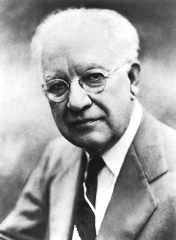
Collective Behavior
First Defined by sociologist Robert Park
Collective Behavior: A group of individuals behaving in a similar way
It can be planned and coordinated, but often is spontaneous and unplanned
Examples
Individuals standing in line for a new product release
Posting messages online to support a cause or to show support for an individual

Slide 33
I. Collective Behavior Analysis

Slide 34
Collective Behavior Analysis
We can analyze collective behavior by analyzing individuals performing the behavior
We can then put together the results of these analyses
The result would be the expected behavior for a large population
OR, we can analyze the population as a whole
Not very popular for analysis, as individuals are ignored
Popular for Prediction purposes

Slide 35
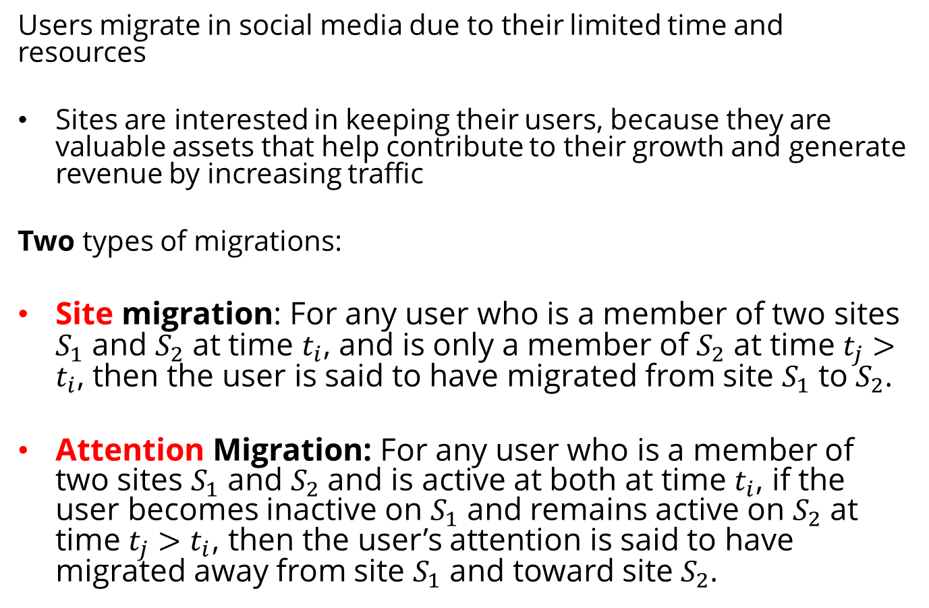
Example – Analyzing User Migrations
Users migrate in social media due to their limited time and resources
Sites are interested in keeping their users, because they are valuable assets that help contribute to their growth and generate revenue by increasing traffic
Two types of migrations:
Site migration: For any user who is a member of two sites $S_{1}$ and $S_{2}$ at time $t_{i}$, and is only a member of $S_{2}$ at time $t_{j}>t_{i}$, then the user is said to have migrated from site $S_{1}$ to $S_{2}$.
Attention Migration: For any user who is a member of two sites $S_{1}$ and $S_{2}$ and is active at both at time $t_{i}$, if the user becomes inactive on $S_{1}$ and remains active on $S_{2}$ at time $t_{j}>t_{i}$, then the user’s attention is said to have migrated away from site $S_{1}$ and toward site $S_{2}$.

Slide 36
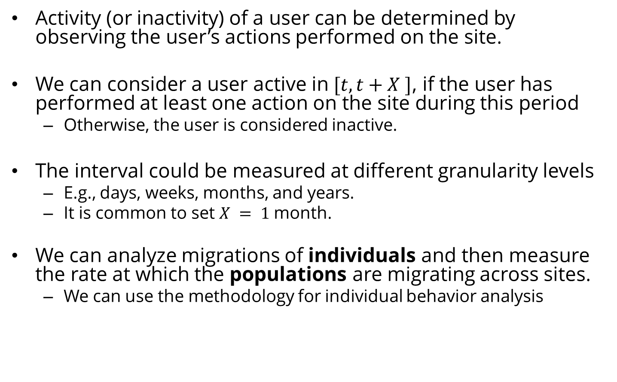
Collective Behavior Analysis - Example
Activity (or inactivity) of a user can be determined by observing the user’s actions performed on the site.
We can consider a user active in $[t, t+X ]$, if the user has performed at least one action on the site during this period
Otherwise, the user is considered inactive.
The interval could be measured at different granularity levels
E.g., days, weeks, months, and years.
It is common to set $X = 1$ month.
We can analyze migrations of individuals and then measure the rate at which the populations are migrating across sites.
We can use the methodology for individual behavior analysis

Slide 37
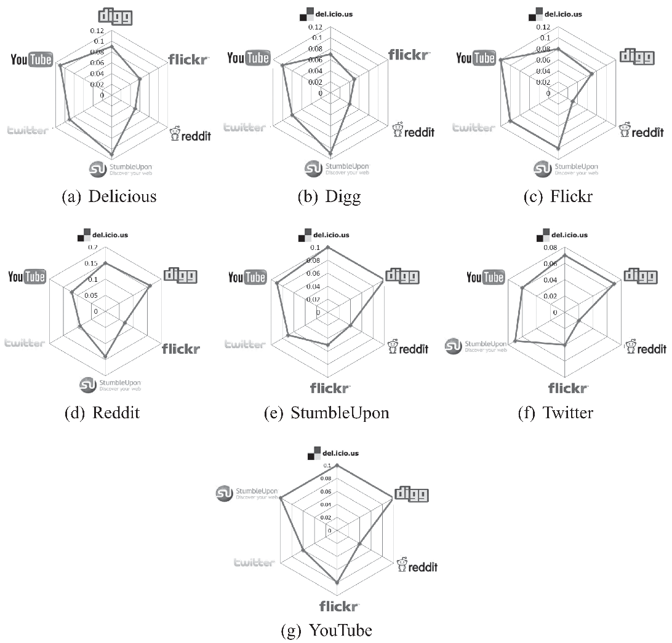
The Observable Behavior
Sites migration is rarely observed
Attention migration is clearly observable
We need to take multiple steps to observe it:
Users are required to be identified on multiple networks (challenging!)
Some ideas: John.Smith1 on Facebook is JohnSmith on Twitter

Slide 38
Features
User Activity: more active users are less likely to migrate
e.g., number of tweets, posts, or photos
User Network Size: a user with more social ties (i.e., friends) in a social network is less likely to move
e.g., number of friends
User Rank: a user with high status in a network is less likely to move to a new one where he or she must spend more time getting established.
e.g., centrality scores
External rank: your citations, how many have referred to your article, ...

Slide 39
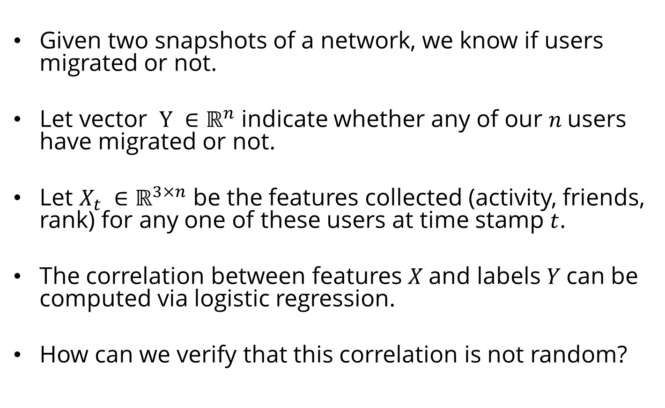
Feature-Behavior Association
Given two snapshots of a network, we know if users migrated or not.
Let vector $Y ∈ℝ^{n}$ indicate whether any of our $n$users have migrated or not.
Let $X_{t} ∈ℝ^{3×n}$ be the features collected (activity, friends, rank) for any one of these users at time stamp $t$.
The correlation between features $X$and labels $Y$can be computed via logistic regression.
How can we verify that this correlation is not random?

Slide 40
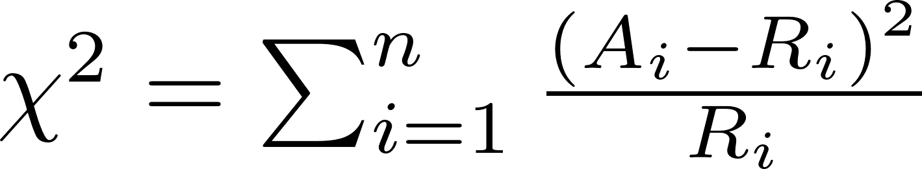
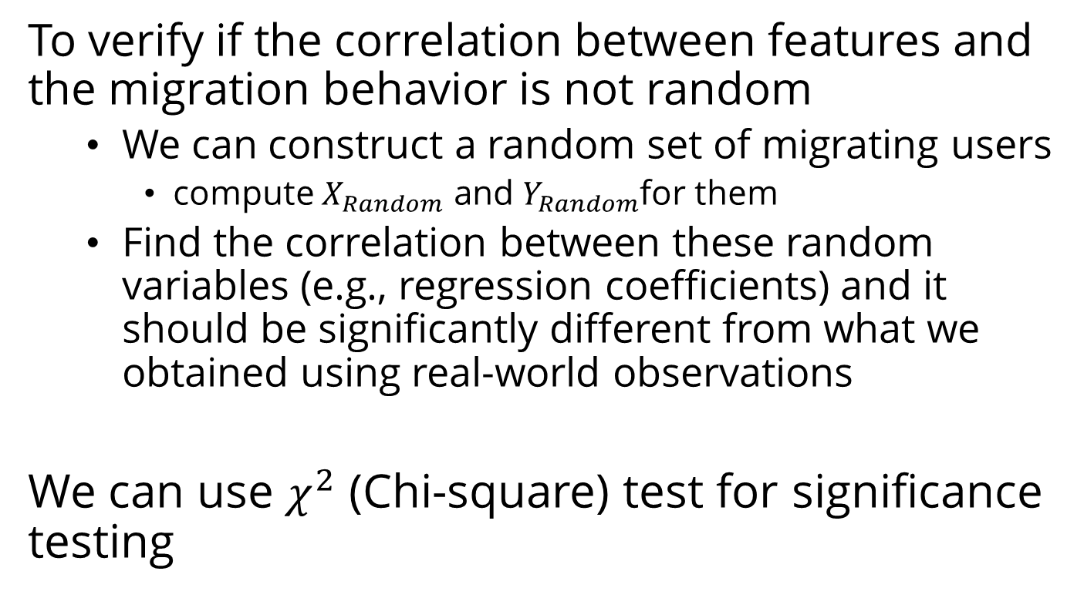
Evaluation Strategy
To verify if the correlation between features and the migration behavior is not random
We can construct a random set of migrating users
compute $X_{Random}$ and $Y_{Random}$for them
Find the correlation between these random variables (e.g., regression coefficients) and it should be significantly different from what we obtained using real-world observations
We can use $χ^{2}$ (Chi-square) test for significance testing
From Original Dataset
From Random Dataset

Slide 41
II. Collective Behavior Modeling

Slide 42
Collective Behavior Modeling
Collective behavior can be conveniently modeled using some of the techniques discussed in Chapter 4 - Network Models.
We want models that can mimic characteristics observable in the population.
In network models, node properties rarely play a role
Reasonable for modeling collective behavior.

Slide 43
III. Collective Behavior Prediction

Slide 44
Collective Behavior Prediction
From previous chapters, we could use
Linear Influence Model (LIM)
Epidemic Models
Collective behavior can be analyzed either in terms of
individuals performing the collective behavior or
based on the population as a whole. (More Common)
When predicting collective behavior,
We are interested in predicting the intensity of a phenomenon, which is due to the collective behavior of the population
e.g., how many of them will vote?
We can utilize a data mining approach where features that describe the population well are used to predict a response variable
i.e., the intensity of the phenomenon
A training-testing framework or correlation analysis is used to determine the generalization and the accuracy of the predictions.

Slide 45
Predicting Box Office Revenue for Movies
Set the target variable that is being predicted
In our example: the revenue that a movie produces.
The revenue is the direct result of the collective behavior of going to the theater to watch the movie.
Identify features in the population that may affect the target variable
the average hourly number of tweets related to the movie for each of the seven days prior to the movie opening (seven features)
The number of opening theaters for the movie (one feature).
Predict the target variable using a supervised learning approach, utilizing the features determined in step 2.
Measure performance using supervised learning evaluation.
The predictions using this approach are closer to reality than that of the Hollywood Stock Exchange (HSX), which is the gold standard for predicting revenues for movies

Slide 46
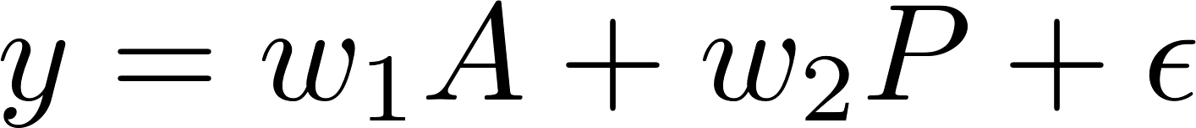
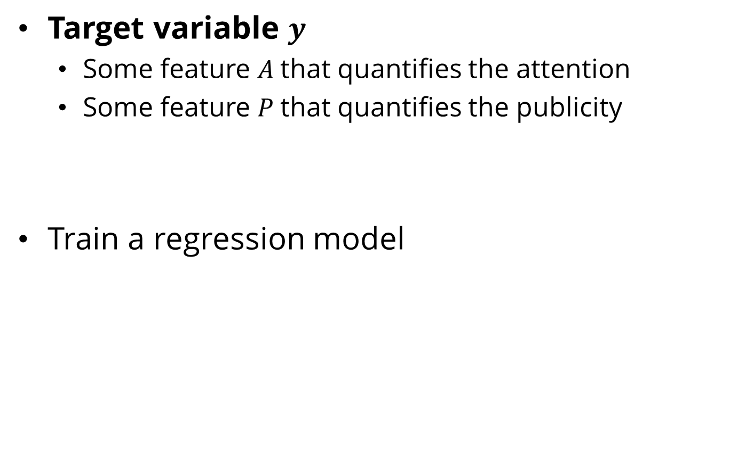
Generalizing the Idea
Target variable $y$
Some feature $A$that quantifies the attention
Some feature $P$that quantifies the publicity
Train a regression model

